Slide 1

Automatic Measurement System for Cargo Volume
Design Review II
Sponsor: Panasonic Mentor: Zhuosi Zhang Instructor: Mingjian Li
Presented by Group 17

Slide 2





Team Introduction
Team Members:
Zesen Wang (Leader)
JI ECE + KTH ML
Xinyi Wu
JI ECE + UM DS
Yier Zhang
JI ECE + UM EE
Yetong Zhang
JI ME + UM CE
Zitao Zhang
JI ECE + KTH ML

Slide 3
Background Recap
Motivation: Quickly growing demand of cargo delivery in China. Demand on
Fast packing and loading process
Efficient usage of vehicle capacity
Accurate freight calculation

Slide 4
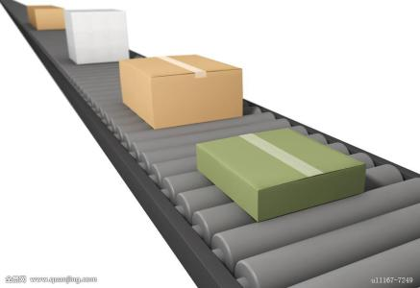
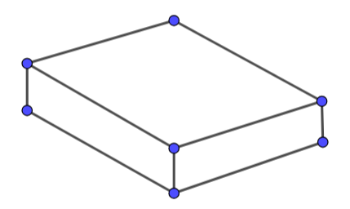
Customer Requirements
Projective:
Accurate measurement of the volume of goods on a conveyor belt
Automatic running
Standardized measurement process
Easy to build, install and use
Low-cost
Expected outcome:
Volume of the goods
3-D model map of the goods
Image Referenece: https://ss0.bdstatic.com/70cFuHSh_Q1YnxGkpoWK1HF6hhy/it/u=3831402330,1049417822&fm=200&gp=0.jpg

Slide 5
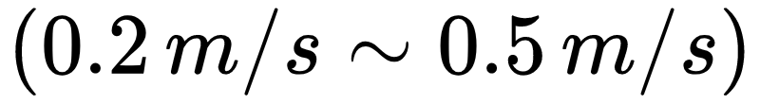
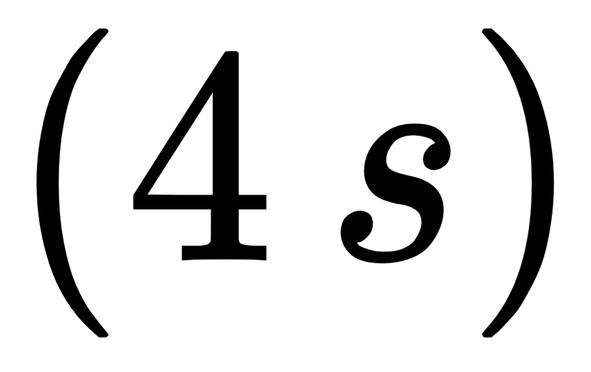
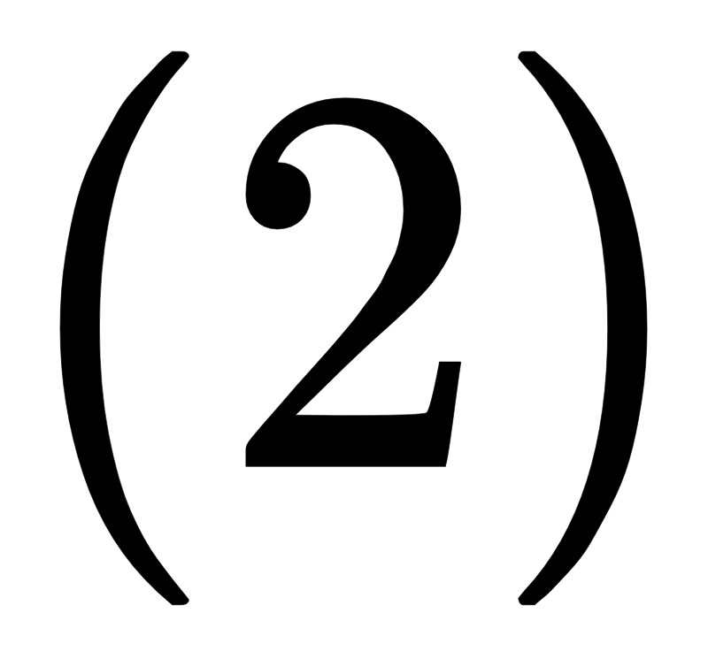
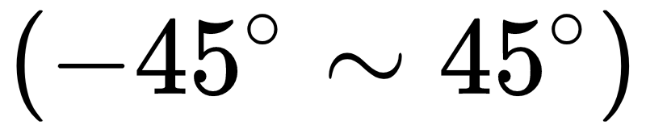
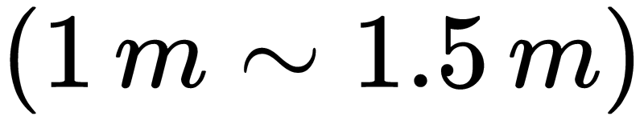
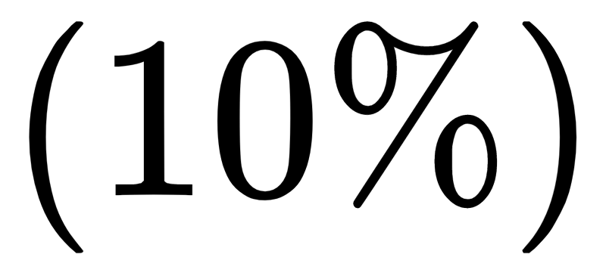
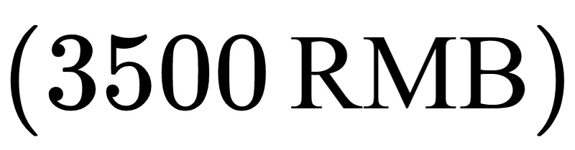
Quantity of ES
Background
Speed of conveyor belt
Cargo size range
Processing time
Design Detail
Number of depth cameras
Filming angle range
Camera distance
Technical Objective
Max unilateral error
Cost restriction

Slide 6
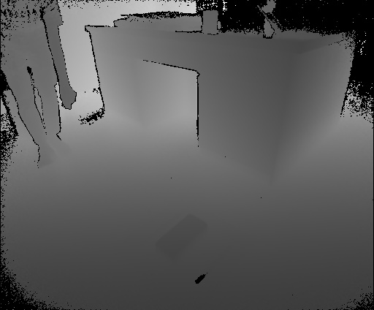
Accuracy Issue

Slide 7
Update of ES
Background
Speed of conveyor belt
Cargo size range
Processing time
Design Detail
Number of depth cameras
Filming angle range
Camera distance
Technical Objective
Max unilateral error
Cost restriction

Slide 8
Update of ES
Background
Speed of conveyor belt
Cargo size range
Processing time
Design Detail
Number of depth cameras
Filming angle range
Camera distance
Technical Objective
Max unilateral error
Cost restriction

Slide 9
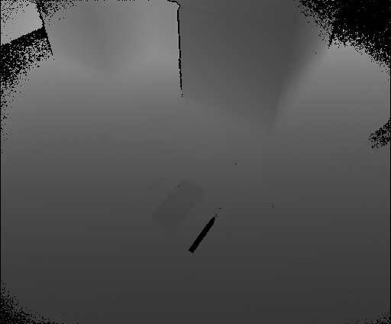
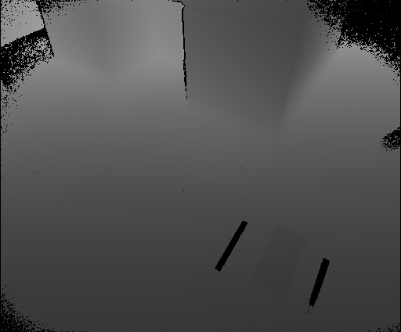
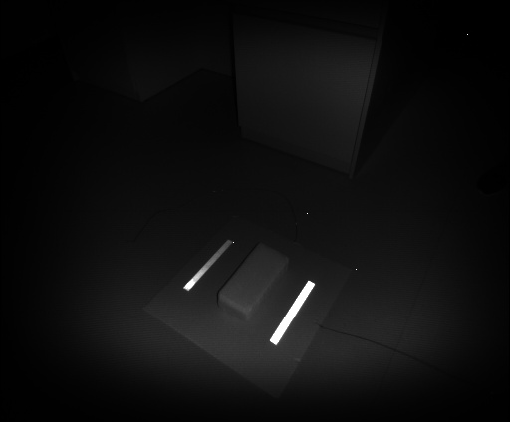
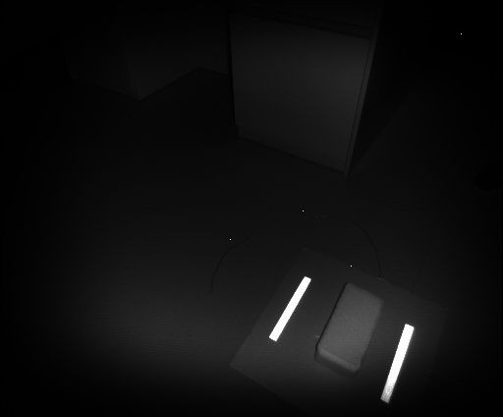
Depth Sensor vs. IR Sensor

Slide 10
Update of ES
Background
Speed of conveyor belt
Cargo size range
Processing time
Design Detail
Number of depth cameras
Filming angle range
Camera distance
Technical Objective
Max unilateral error
Cost restriction

Slide 11
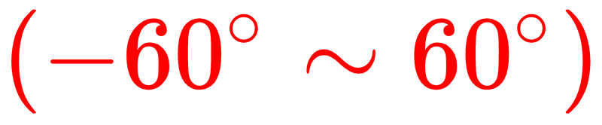
Update of ES
Background
Speed of conveyor belt
Cargo size range
Processing time
Design Detail
Number of depth cameras
Filming angle range
Camera distance
Technical Objective
Max unilateral error
Cost restriction

Slide 12
Functional Decomposition
Mechanical Structures:
Conveyor belt & reflection tape
Camera & supports
Software Parts:
Point cloud generation & background elimination
Cargo detection
Coordinate conversion & point cloud alignment
Volume estimation
3-D model output

Slide 13
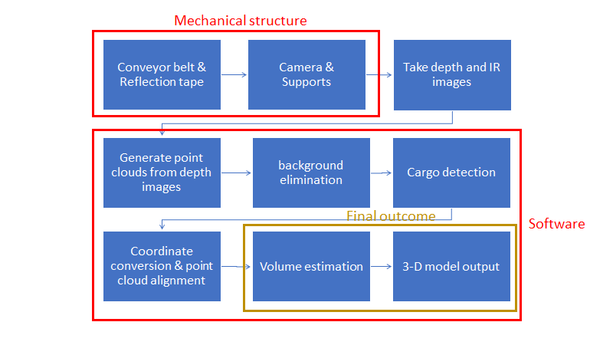
Function Flow Chart

Slide 14
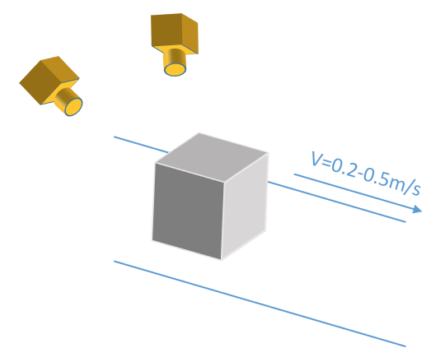
Design
Camera positions
Marker
Alignment method

Slide 15
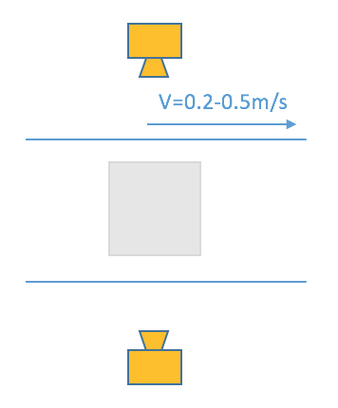

Designs - Camera Positions #1

Slide 16
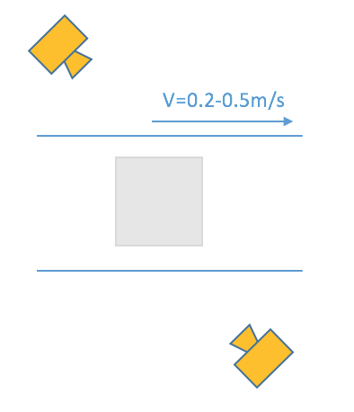
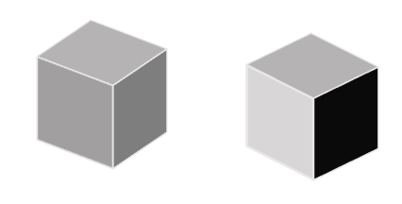
Designs - Camera Positions #2

Slide 17
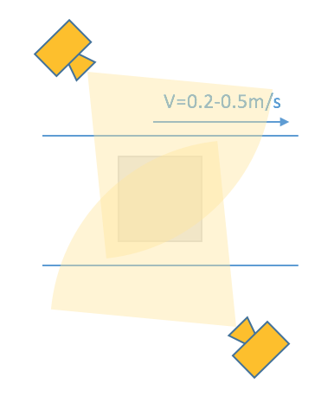
Designs - Camera Positions #2

Slide 18
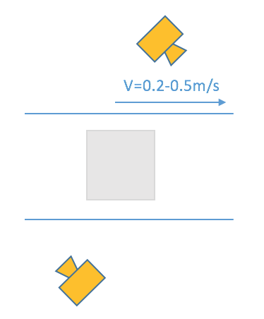
Designs - Camera Positions #3

Slide 19
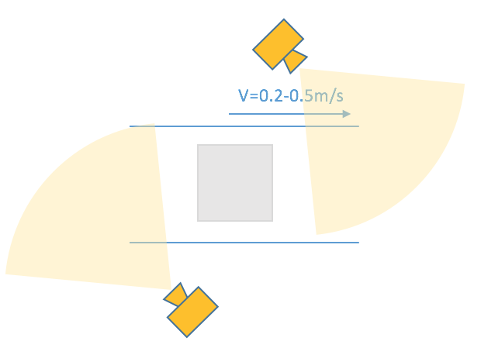
Designs - Camera Positions #3

Slide 20
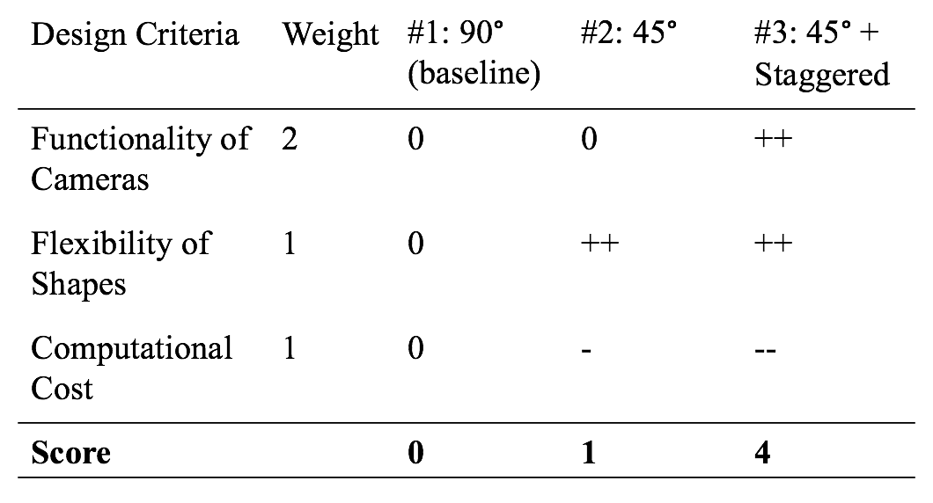
Designs - Camera Positions

Slide 21
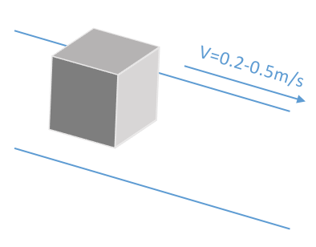
Designs - Marker #1

Slide 22
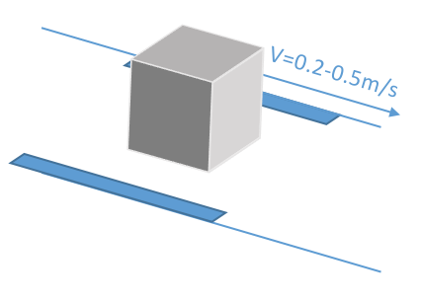
Designs - Marker #2

Slide 23
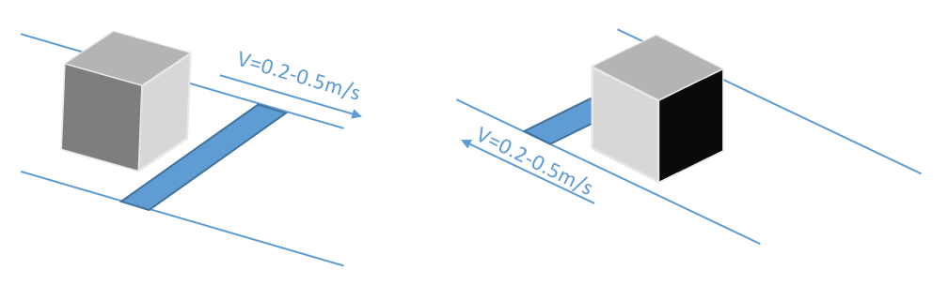
Designs - Marker #3

Slide 24
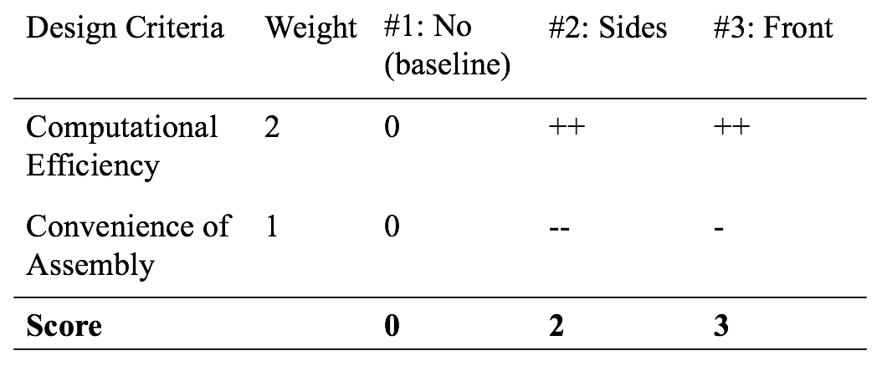
Designs - Marker

Slide 25
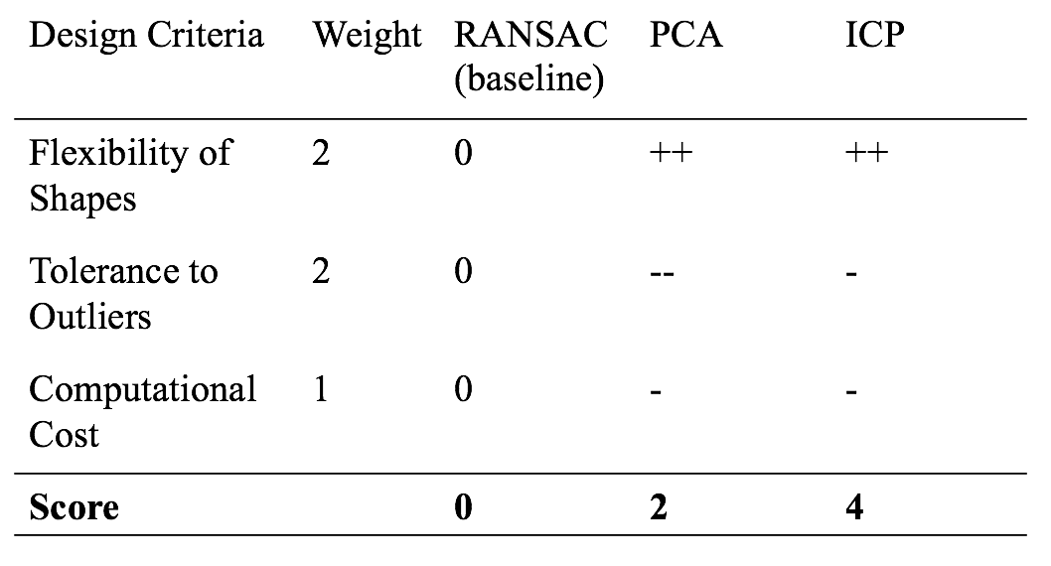
Designs - Alignment Method

Slide 26
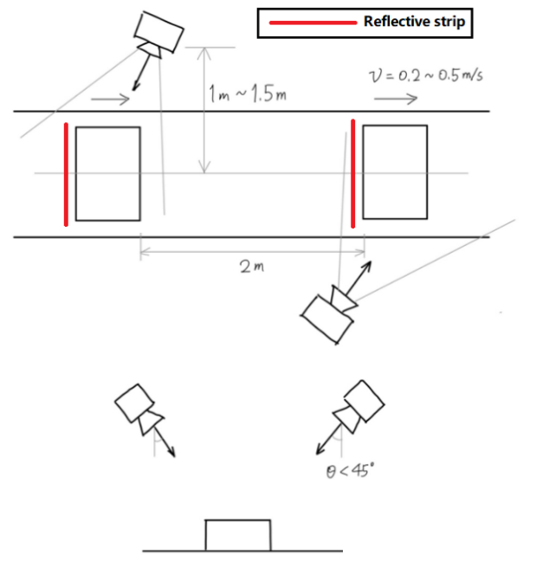
Selected Design
Top view
Side view

Slide 27
Main Procedure
Use reflective strip to locate
Generate point clouds from multiple frames
Align and combine point clouds from one camera
Combine the final point clouds from two cameras

Slide 28
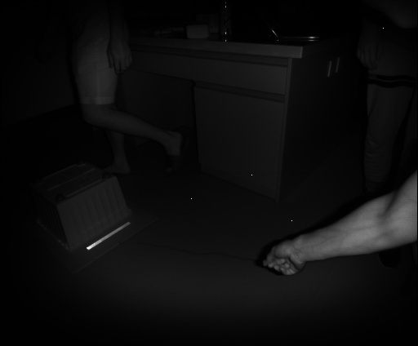
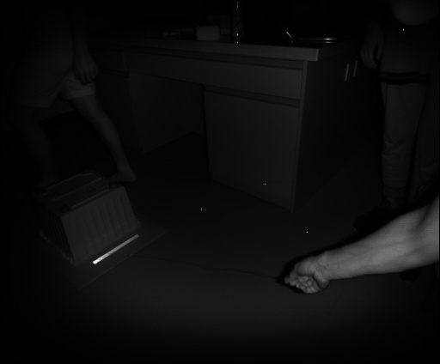
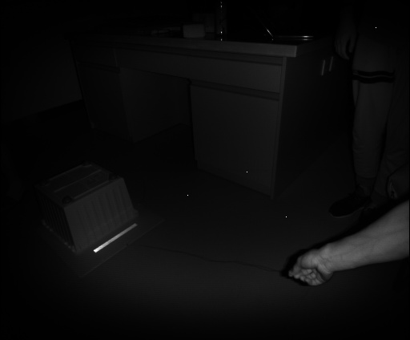
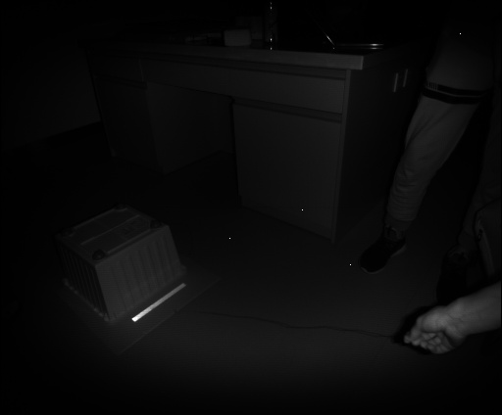
Infrared Camera

Slide 29
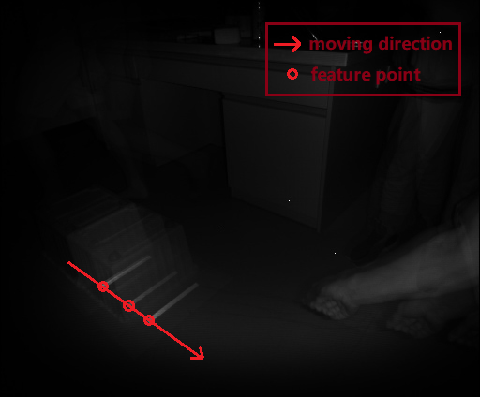
Align Point Clouds from One Camera

Slide 30
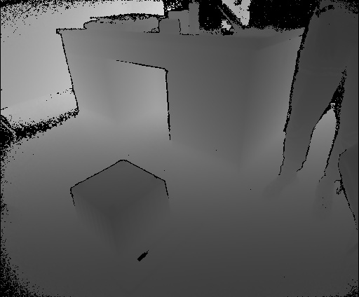
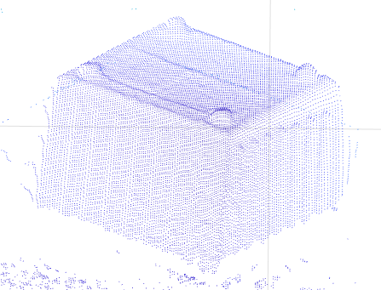
Depth Image to 3D Point Clouds

Slide 31
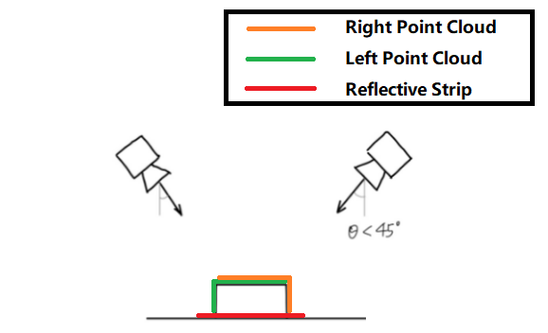
Align Point Clouds from Two Camera
Use Iterative Closest Point Algorithm to combine two point clouds.
Find the overlap part with the help of strips.

Slide 32
Challenges
Background Elimination
moving object
Reflection tape detection
occlusion
aliasing
point cloud alignment:
Lack of features for cubic and cylindrical objects
Post-processing after alignment
Disagreement of point clouds

Slide 33
Final “deliverable”
Mechanical Structures
A moving conveyor belt
Two kinect cameras by the belt with fixture devices
Algorithms
Background elimination
point cloud alignment
Shape generation
Visualization
visualization of point cloud
visualization of fitted shape
Demo
real-time visualization of the object shape

Slide 34
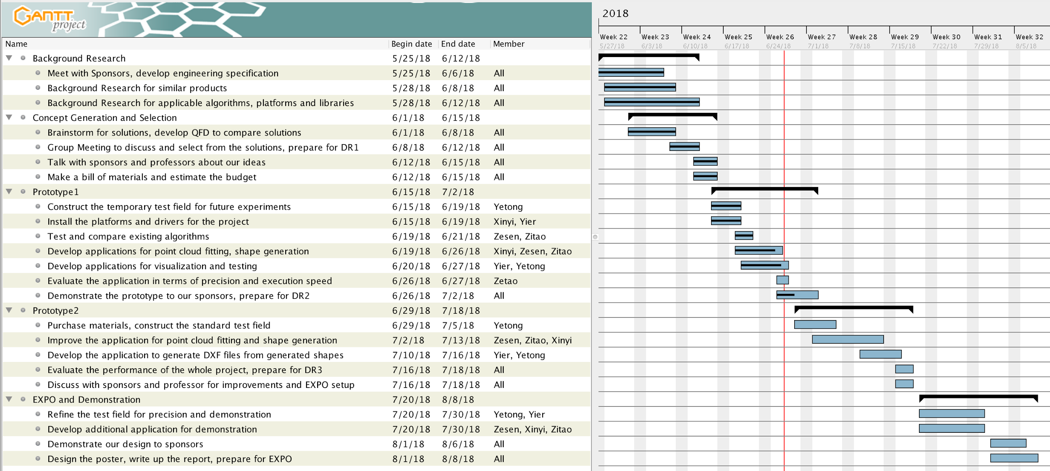
Project Schedule
DR1
DR2
DR3
EXPO

Slide 35
Customer Requirements and Engineering Specifications
Customer requirements:
High efficiency
Save manpower
Low cost
Standardize the measurement process
Easy to build and install
Easy to use
High accuracy
Different cargo size capacity
Special-shape cargo measurement
Visualization output
Engineering Specifications:
Speed of conveyor belt
Cargo size range
Processing time
Number of depth cameras
Filming angle range
Camera distance
Max unilateral error
Cost restriction

Slide 36
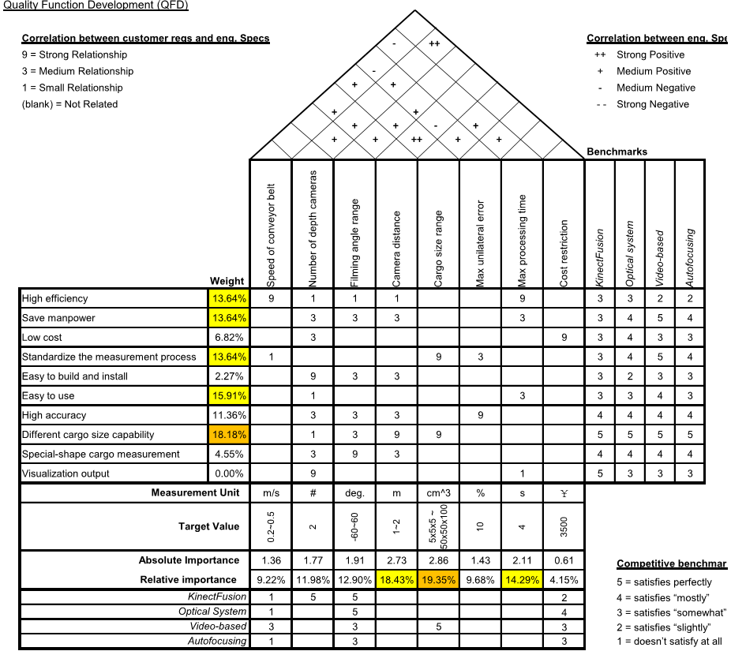
Quality Function Development
-45~45
1~1.5

Slide 37
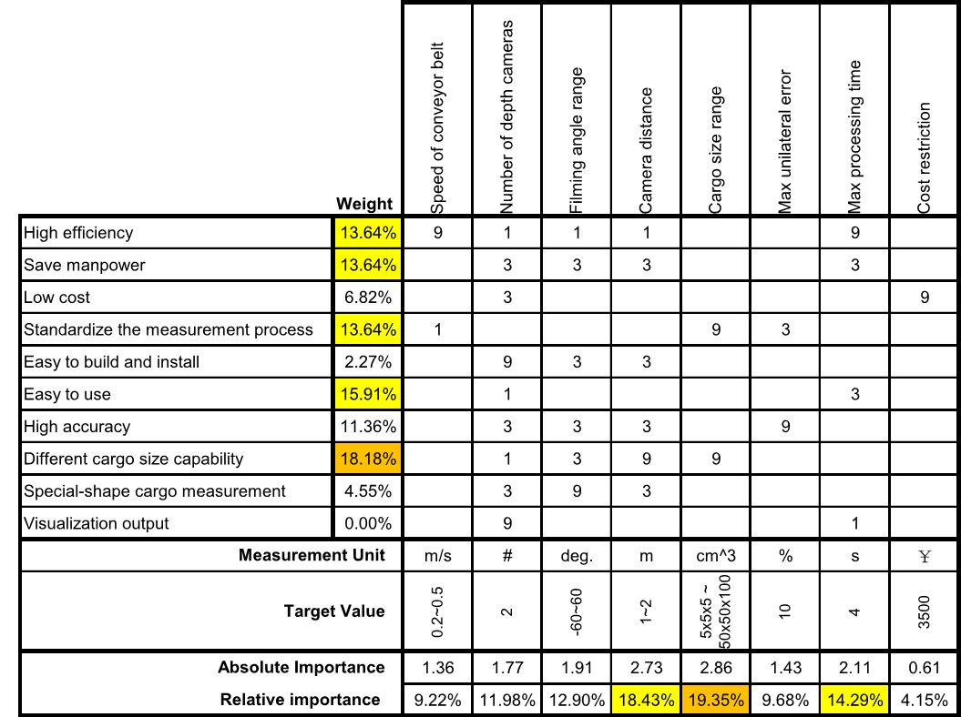
Quality Function Development
-60~60
1~1.5

Slide 38
Reference
[1] Newcombe, Richard A., et al. "KinectFusion: Real-time dense surface mapping and tracking." Mixed and augmented reality (ISMAR), 2011 10th IEEE international symposium on. IEEE, 2011.
[2] J. Loera, J. Rambau and F. Santos (2010), Triangulations: Structures and Algorithms (2nd revised ed.), Springer-Verlag, ISBN 9783642129711 Chapter 3: Polygon Triangulation: pp.103.
[3] Besl, Paul J.; N.D. McKay (1992). "A Method for Registration of 3-D Shapes". IEEE Trans. on Pattern Analysis and Machine Intelligence. Los Alamitos, CA, USA: IEEE Computer Society. 14 (2): 239–256. doi:10.1109/34.121791
[4] Pirovano, Michele. "Kinfu–an open source implementation of Kinect Fusion+ case study: implementing a 3D scanner with PCL." no. October 2012 (2011).
[5] Kakinoki, Yoshikazu, Masato Nakashima, Tetsuo Koezuka, Noriyuki Hiraoka, Hiroyuki Tsukahara, Yoshinori Suto, Yoshitaka Oshima, and Shinji Hashinami. Optical System for Detecting Three-dimensional Shape. Fujitsu Ltd, assignee. Patent US5004929A. 2 Apr. 1991. Print.
[6] Itsuzaki, YasuoYoshihiro, Masatoshi Nakamura, Noriyuki Suzuki, Misuzu Takano, and Kinji Horikami. Shape Detection Apparatus. Panasonic Corp, assignee. Patent US5995663A. 30 Nov. 1999. Print.
[7] Nakagawa, Yasuo, and Shree Nayer. Method of Detecting Solid Shape of Object with Autofocusing and Image Detection at Each Focus Level. Hitachi Ltd, assignee. Patent US5151609A. 29 Sept. 1992. Print.
[8]. Specification for “Heavy Duty Slider Bed Conveyor - Model TL 42" OAW, 17'-1" long”,
Hytrol Conveyor Company, Inc. http://www.cisco-eagle.com/catalog/product/12410/
heavy-duty- slider-bed-conveyor-model-tl-42-oaw-17-1-long
[9]. “Kinect for Windows Sensor Components and Specifications” https://msdn.microsoft.com/en-us/library/jj131033.aspx
[10]. K. Khoshelham, S.O. Elberink, “Accuracy and resolution of Kinect depth data for indoor mapping applications”, Sensors, 12:1437–1454, 2012.
[11]. Li, Lingling, Z. Wang, L. Qing, and H. He, “Fast Volume measurement based on Kinect 2.0 depth image”, Microcomputer & Its Applications, vol. 1, no. 7, 2017, pp. 35-38.
[12]. Dellen, Babette, I. Rojas, “Volume measurement with a consumer depth camera based on
structured infrared light”, 16th Catalan Conference on Artificial Intelligence, poster session, 2013, Vic, Spain, pp. 1-10, ACIA.

Slide 39
Presented by Group 17

Slide 40
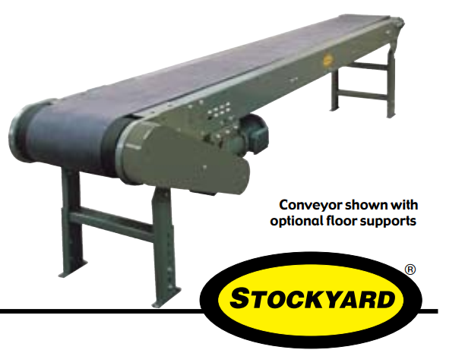
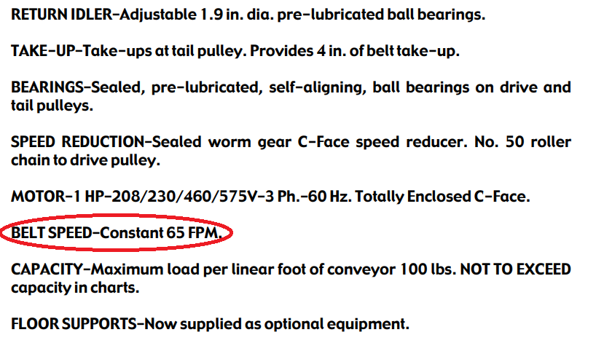
Speed of Conveyor Belt
Heavy Duty Slider Bed Conveyor - Model TL 42" OAW, 17'-1" long
=0.33m/s

Slide 41
Processing Time
2 meters space between two goods
0.5 m/s maximum speed
T_min = 2 / 0.5 = 4s

Slide 42
Cost Restriction
Kinect 2.0 x 2 1488 * 2 = 2976RMB
Camera Support x 2 30 * 2 = 60RMB
Light Reflection Tape 10RMB/m * 20 m = 200RMB

Slide 43
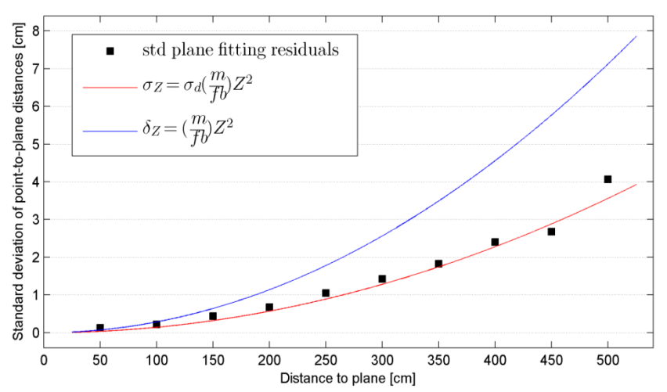
Max Unilateral Error
errors increase quadratically with camera distance
About 0.5 cm deviation at 1.5 m distance
Max unilateral error = 0.5cm/5cm = 10%
“Kinect for Windows Sensor Components and Specifications” https://msdn.microsoft.com/en-us/library/jj131033.aspx

